Slide 1
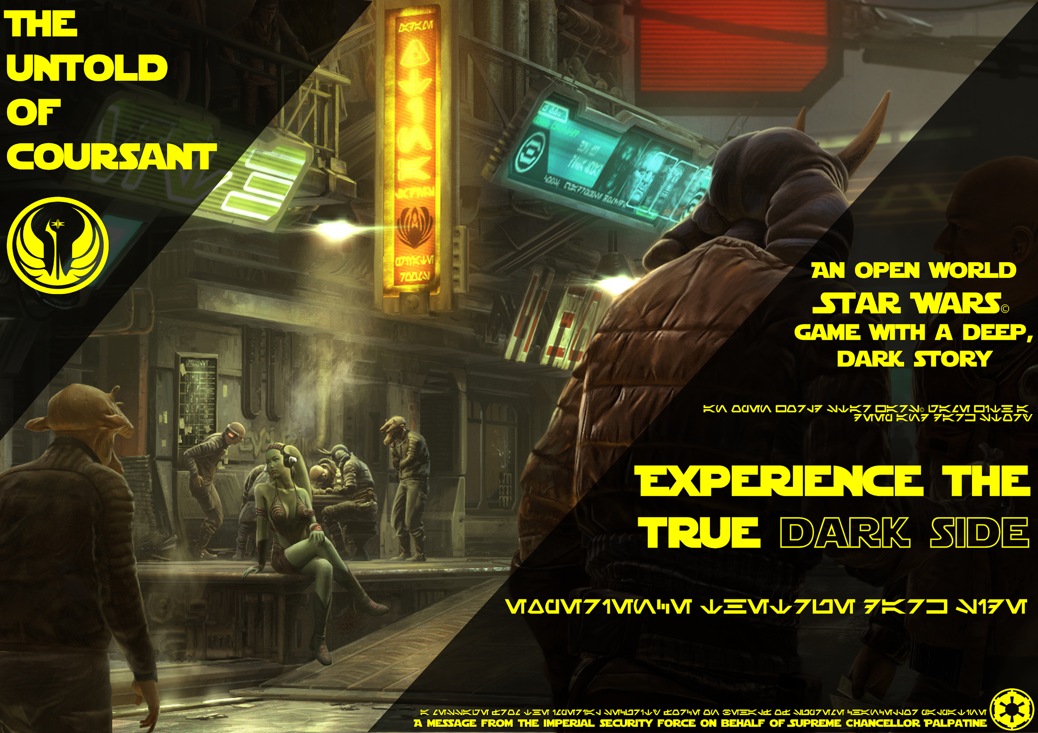

Slide 2
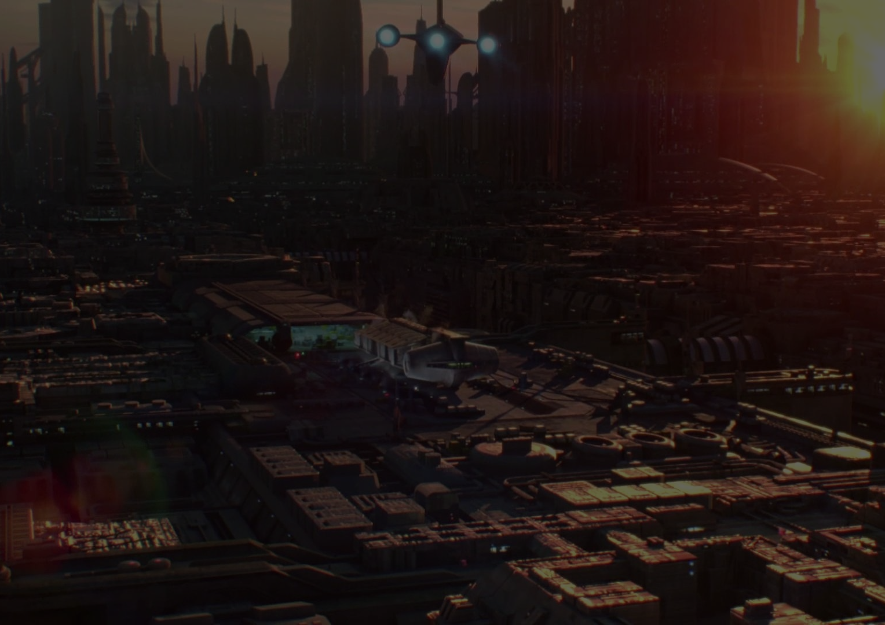
Market Overview
PC, Xbox One and Playstation 4 systems
Game Market
  Casual Games
  Crime Games
  Story Based Games

Slide 3
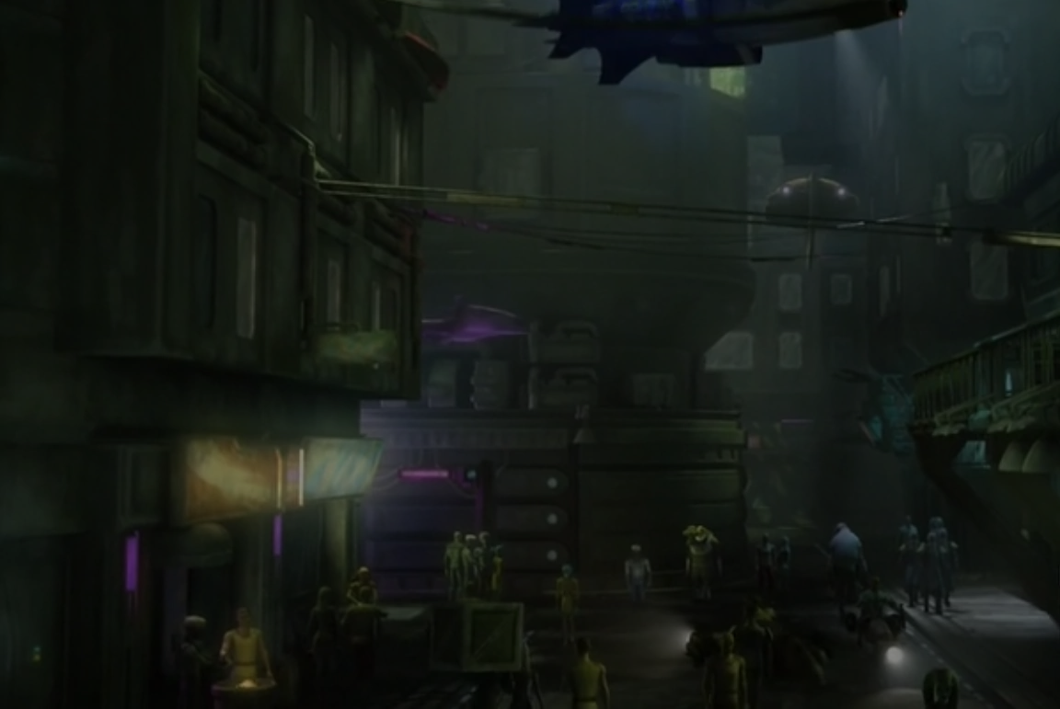
Market Opportunity
Similar games proven successful
Release of New Star Wars Movies
Market for Star Wars Games Growing
  New Star Wars Games on High Demand

Slide 4
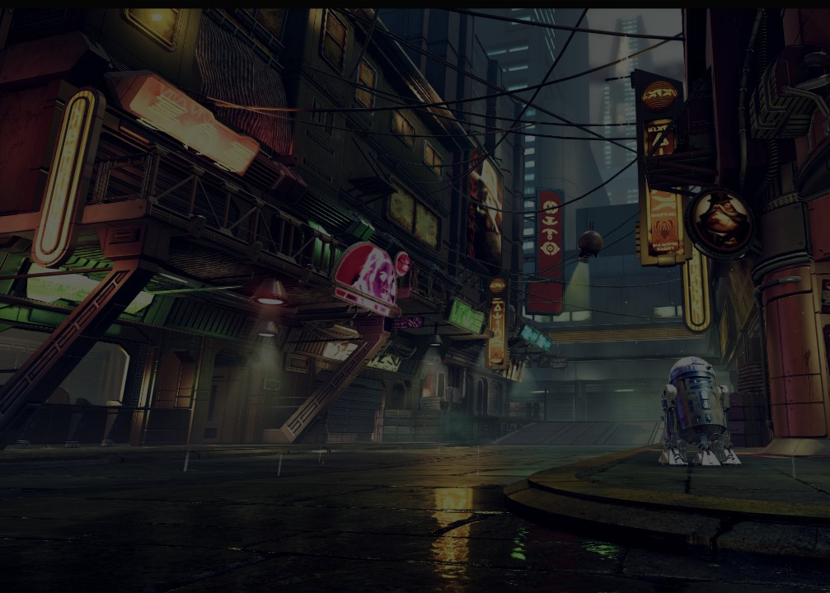
Game Overview
Single Player
Story Based
Dark and Violent
  Emotional setting
  Target Audience

Slide 5
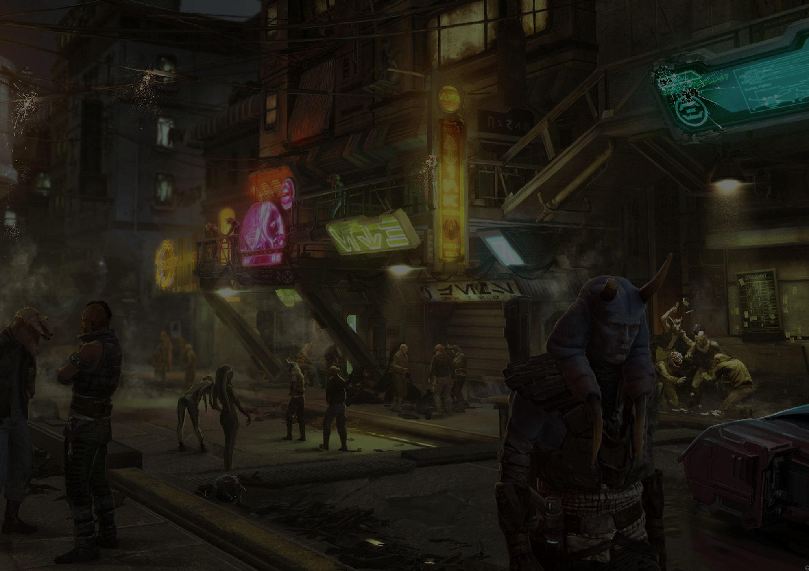
Inspiration
Star Wars franchise
Cyberpunk subgenre
Story Driven Games
Crime focused Games
Open world Games

Slide 6
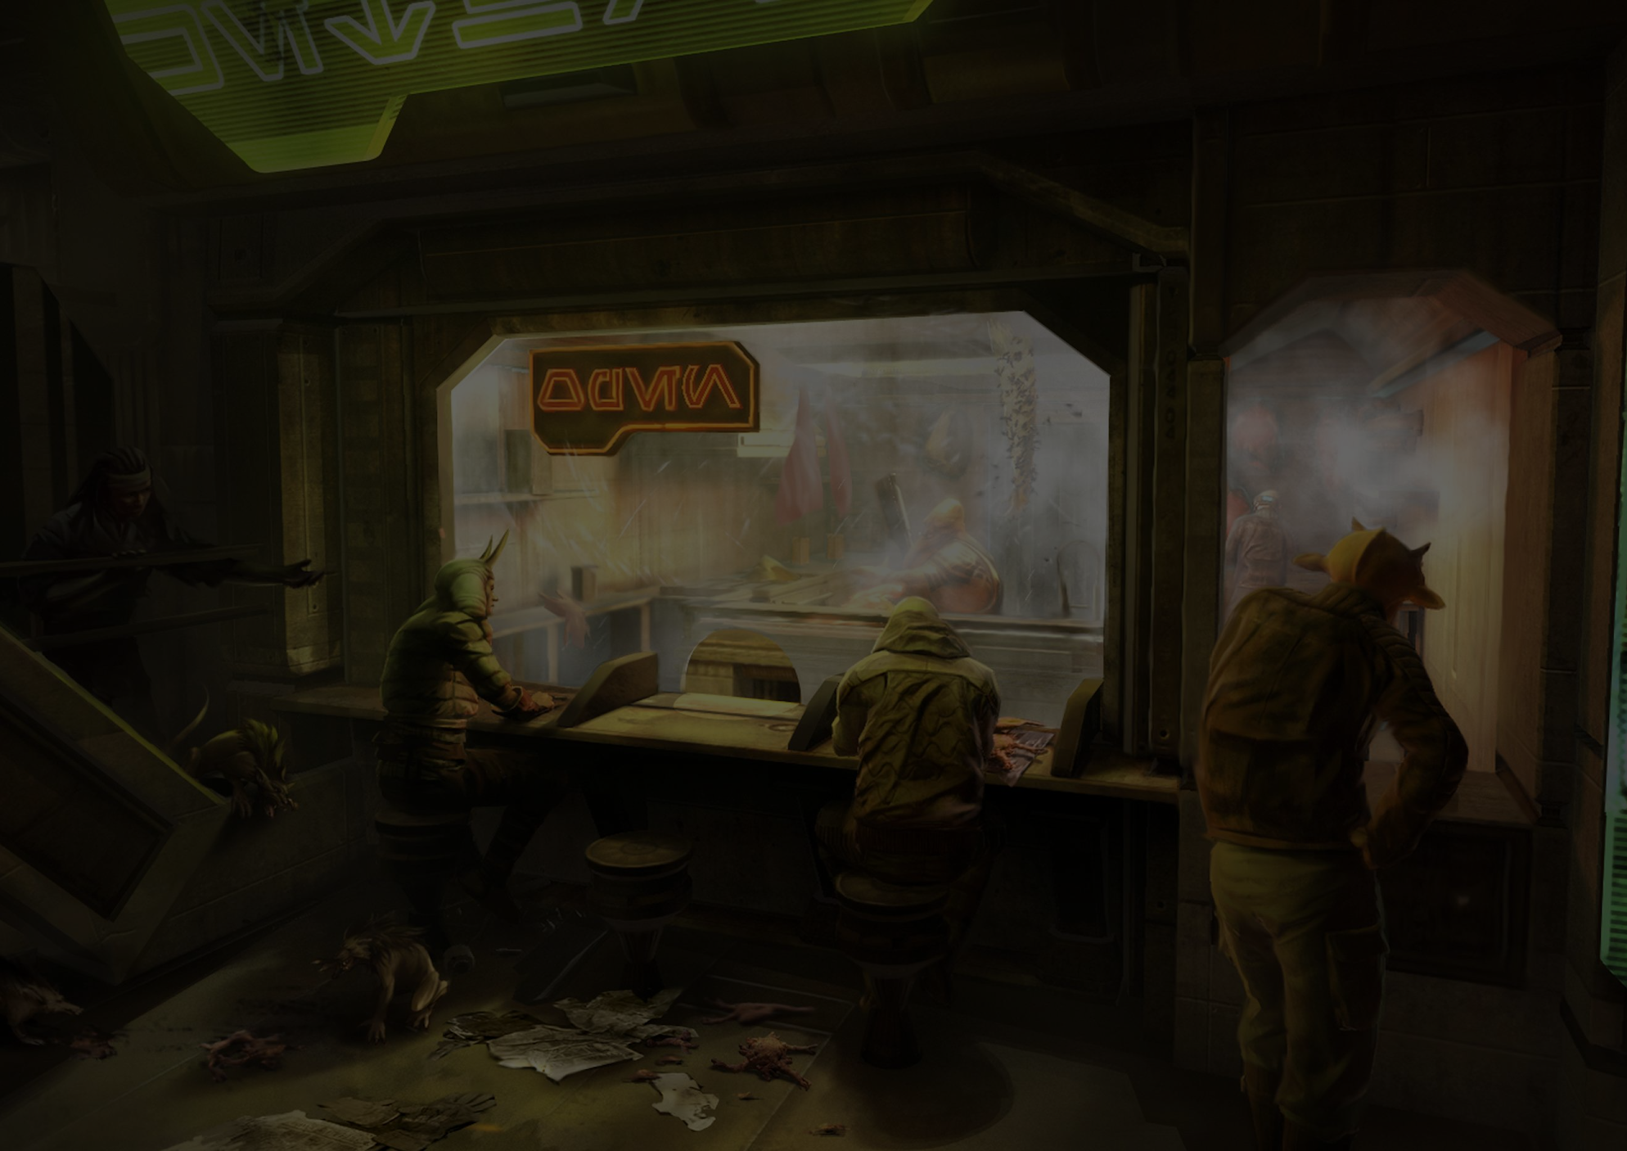
Game World & Theme
Open World
Set in the Underworld of Coruscant During the Imperial Era
Star Wars / Cyberpunk themed
  Visuals of Poverty, Crime and Hardship

Slide 7
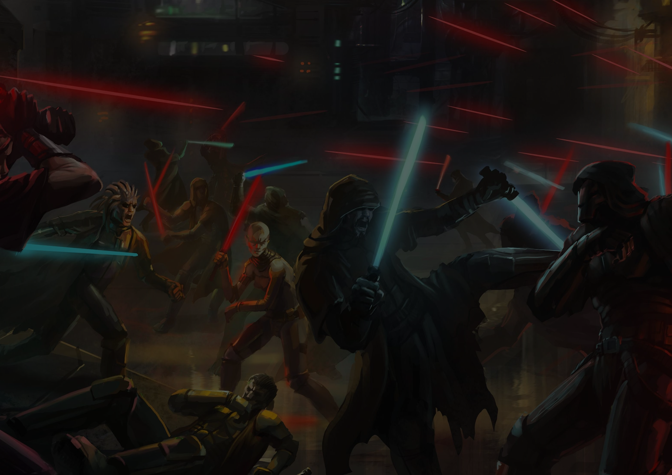
Gameplay Style
Think of it as Star Wars meets
Mafia / Grand Theft Auto / Saints Row
3rd Person Shooter
Territorial Gang Warfare
Interaction with Environment

Slide 8
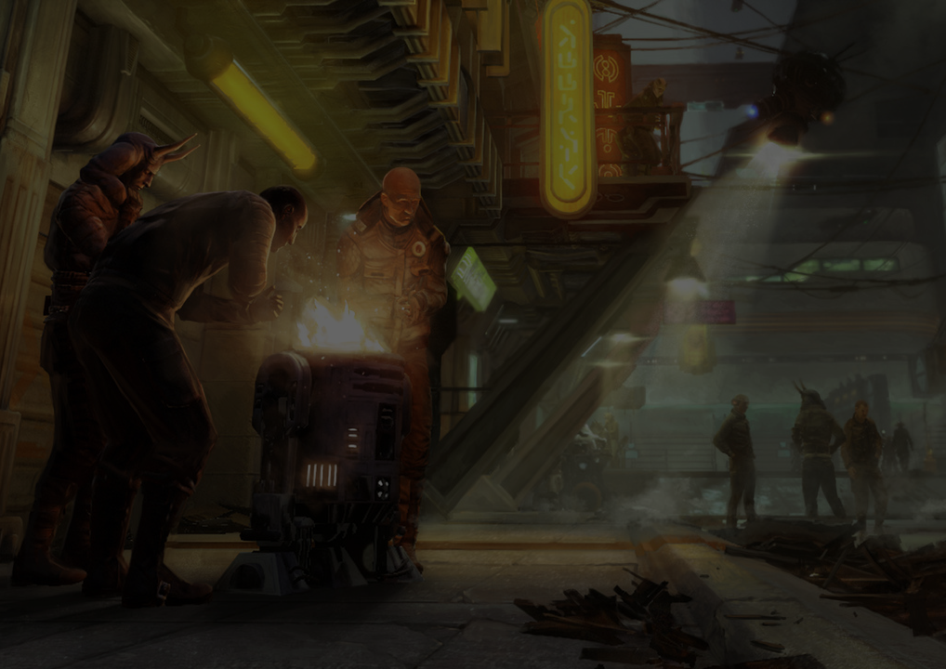
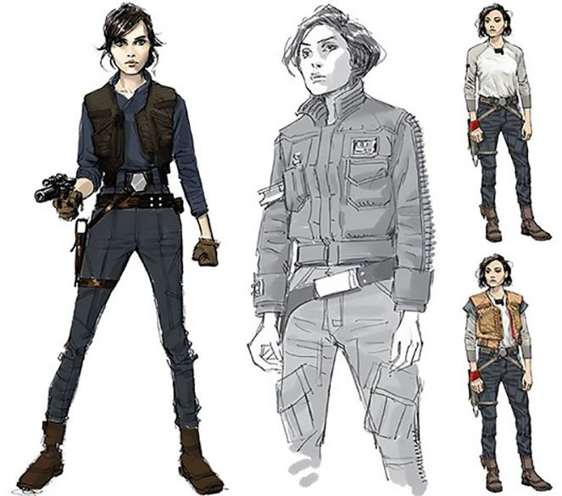
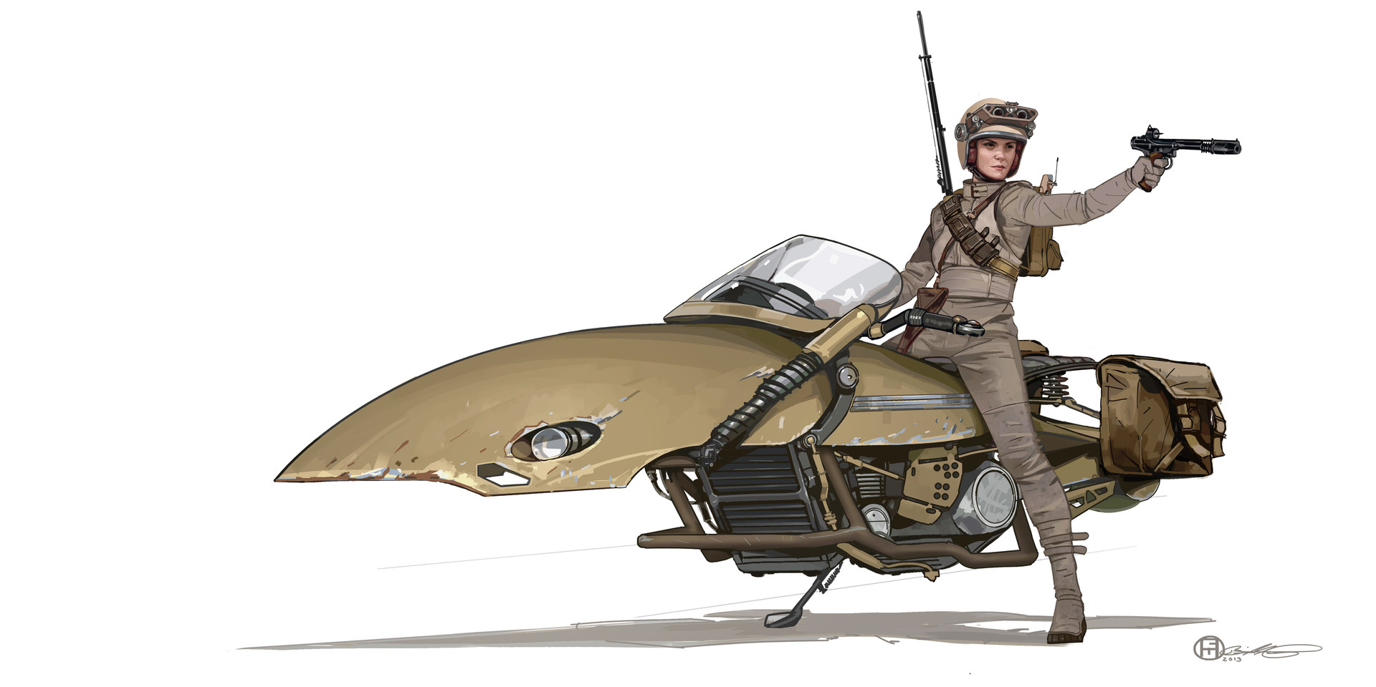
Characters & Story
Heavy Emotional Story Setting
One Playable Character
NPC Interactions with the Player
Notable Emotional impact on Characters
Alisia character concept art
Alisia’s speeder (“Whirlwind”) and her blaster (“The Persuader”) concept art

Slide 9
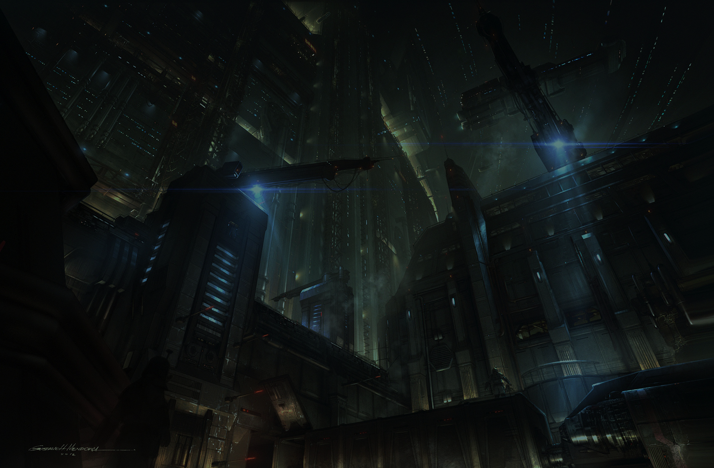
Unique Factors
Theme
Gameplay
Audio
Story
No Evidence of a Similar Game Style

Slide 10
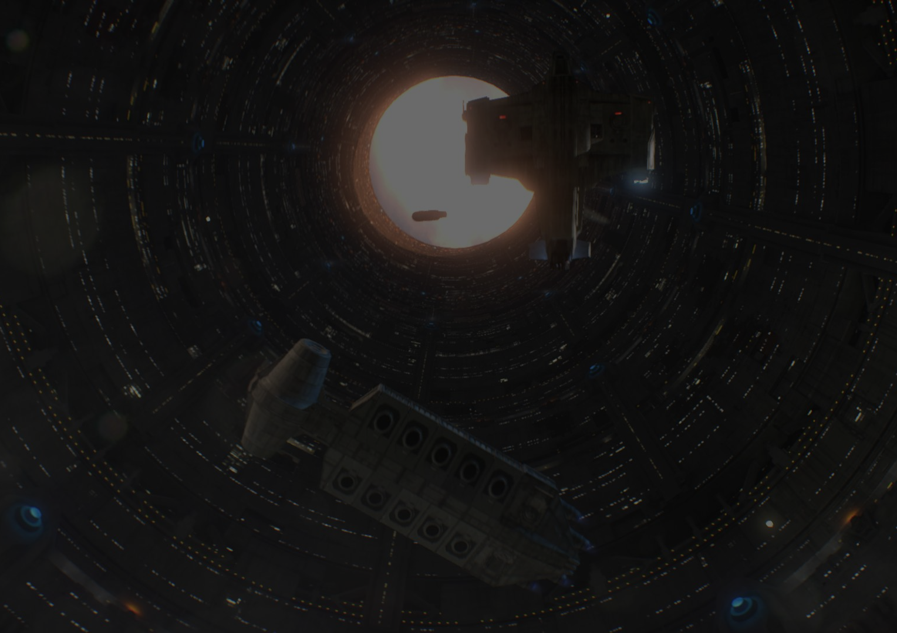
Development Goals
Concept for Story
Concept for Gameplay
Concept for Game World
Further Testing
Full Release

Slide 11
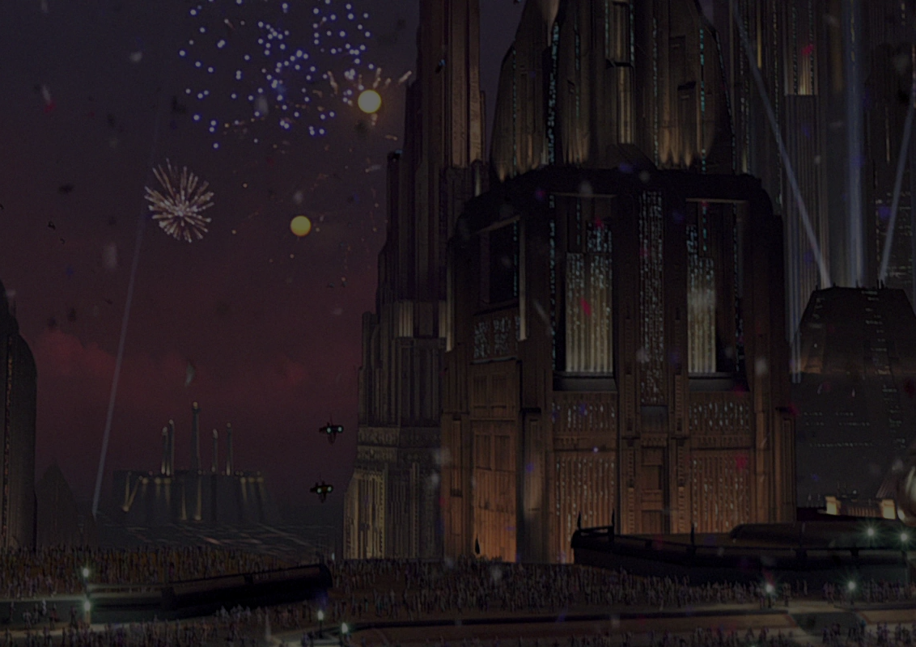
Current Status
Concept Art
Game Documentation
In the Progress of Story Writing
Pre-Prototype
Testing Proof of Story

Slide 12
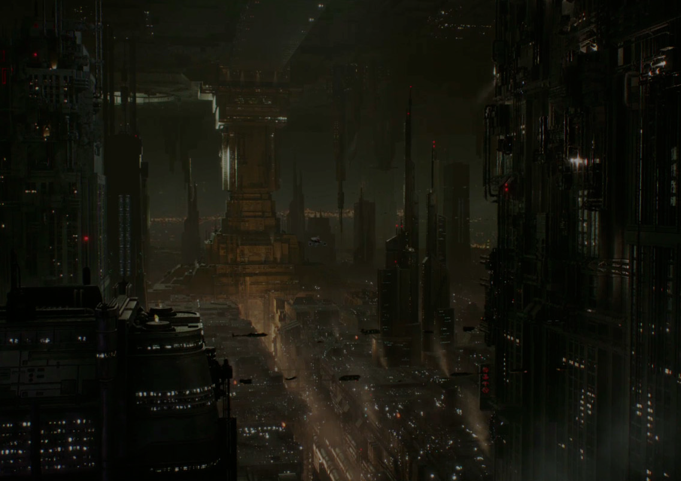
Questions & Answers

Slide 13
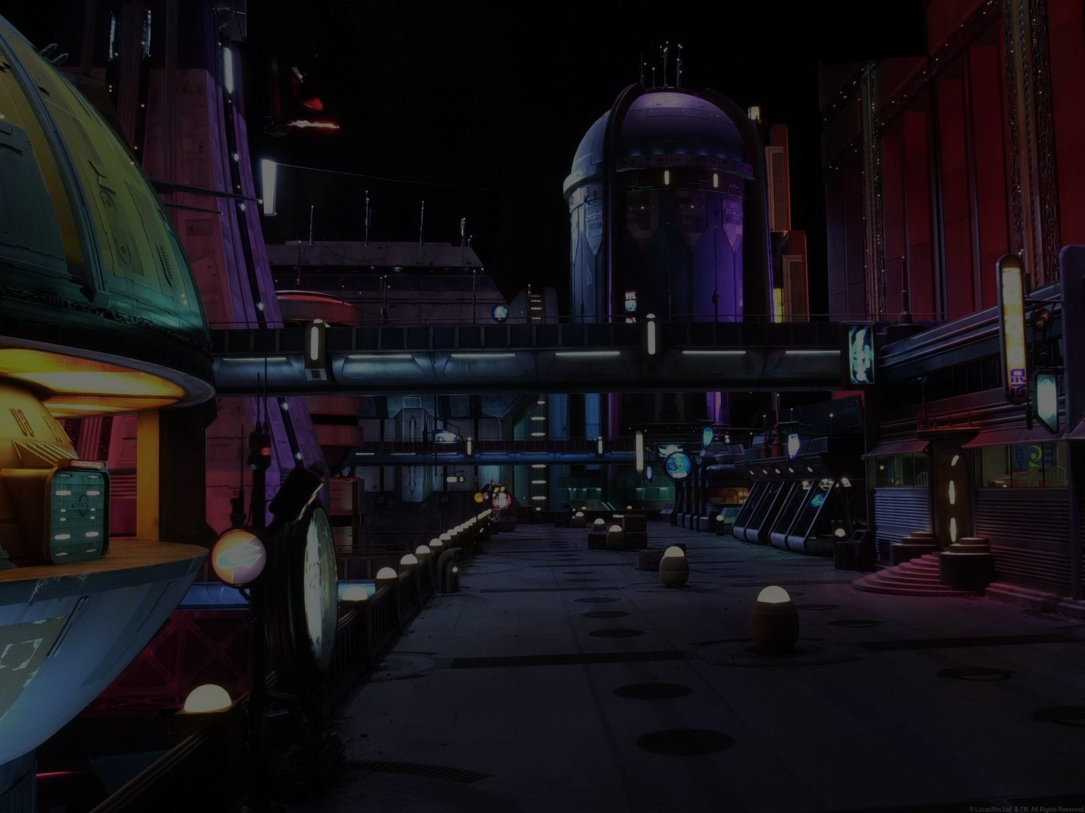
Thank You

